Slide 1

Satellite management database
Atal Bihari Vajpayee Indian Institute of Information Technology and Management, Gwalior
Submitted to:
Prof. Debanjan Sandhya
Submitted by:
Aditya Singh Hada (2020BCS-006)
Hrushikesh Borhade (2020BCS-022)
Paridhi Singhal (2020BCS-055)
Pooja (2020BCS-057)
Sankalp Bhoyar (2020BCS-067)
Anamika Mallick (2020BCS-075)

Slide 2
Introduction:
Our aim is to create a database that can be efficiently used in a satellite information application.
This database will help to manage data that will ignite young minds as well as, will also be a good source of information for scientist all over the world.
This database contains all kind of information that can significantly distinguish and describe every satellite launched by India.
This database also contains detailed information about Indian satellite launching sites, Indian satellite launch vehicles, budget etc.

Slide 3
ENTITIES:
1. Satellite: (Sat-ID, Sat-Name, Sat_Type)
2. Vehicle: (Veh_ID, Veh_name, Weight)
3. Site: (Site_ID, Site_Name, Site_City, Site_State)
4. Budget: (Bug_ID, Bug_Alloted, Sanction_Year, Funding, Total_Bug)
5. Details: (Heaviest_Launch, Launch_pads)

Slide 4
Relationship Sets:
Launched_By: (Sat_ID, Veh_ID)
Launching: ( Sat_ID, Site_ID)
Alloted: (Sat_ID, Bug_ID)
Holds: (Site_ID, Heaviest_Launch)

Slide 5
Relations
Launched_By: This is the relation between satellite and vehicle. This relation is many to one , since each satellite can be launched from only one vehicle but one vehicle can launch many satellite. There is also total participation from satellite as we have assumed that all the satellites are launched from some vehicle.
Launching: This is the relation between satellite and site. This relation is also many to one , as one satellite can be launched from only one site but from one site many satellite can be launched . There exist total participation from satellite site as we have assumed that all satellites are launched.
Allotted: This is the relation between budget and satellite. It is one to one relation, as each satellite has corresponding fixed budget, and for each budget there is a corresponding satellite. There exist total participation from both the side.
Holds: This is the relation between site and details. It holds the information of site. It a one to one relationship, since each site holds its unique details. Now, since details has no primary key, it is a weak entity set. Therefore there exist a total participation from weak entity set. Primary key of strong entity set will act as a foreign key here, since it has no independent existence.

Slide 6
ER-DIAGRAM

Slide 7
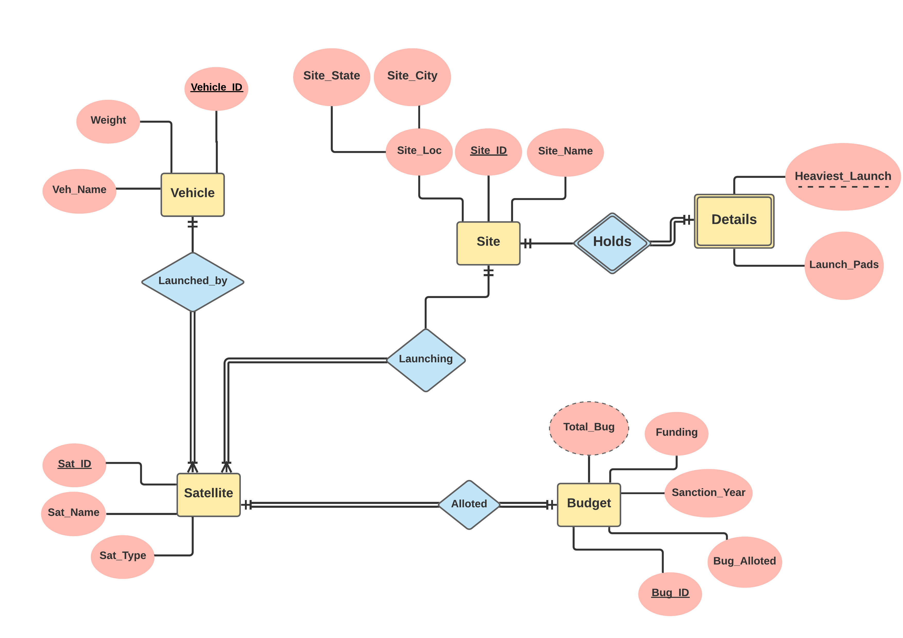

Slide 8
RELATIONAL SCHEMA

Slide 9
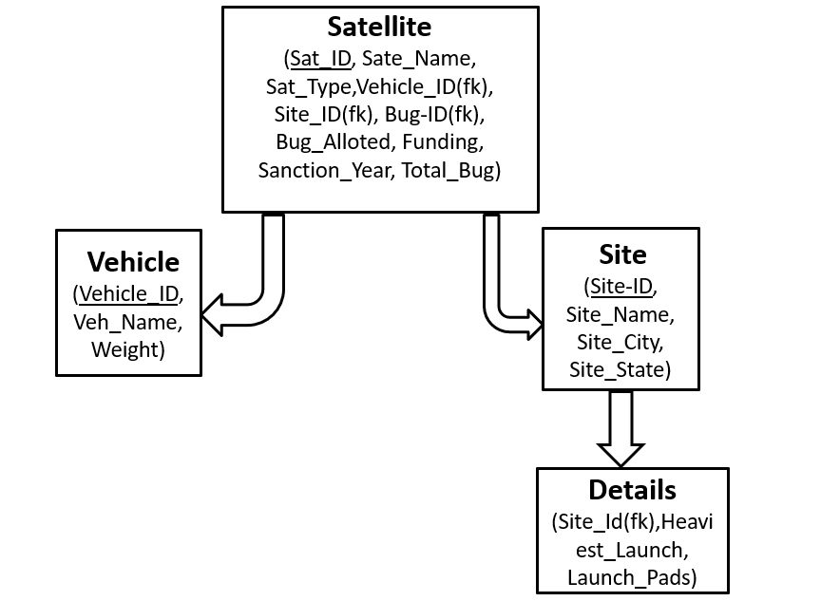

Slide 10
Normalization

Slide 11
Satellite: (Sat-ID, Sat-Name, Sat_Type, Vehicle_ID, Site_ID, Bug-ID, Bug_Alloted, Funding, Sanction_Year, Total_Bug)
F.D = { Sat-ID, Vehicle_ID, Site_ID, Bug_ID → Sat-Name, Sat_Type, Bug_Alloted, Funding, Sanction_Year, Total_Bug;
Bug-ID → Bug_Alloted, Funding, Sanction_Year , Total_Bug;
Funding, Bug_Alloted→ Total_Bug}
Candidate key: Sat_ID, Vehicle_ID, Site_ID, Bug_ID
Non Prime Attributes: Sat-Name, Sat_Type, Bug_Alloted, Funding, Sanction_Year, Total_Bug

Slide 12
This relation is in 1NF as all the attributes in the relation have atomic domains.
This relation is not in 2NF as there exist partial dependency, since Bug_Id which is a part of candidate key determines non prime attributes . Therefore, we reduce it in 2 tables
Satellite_1: (Sat_ID, Sat_Name, Sat_Type, Veh_ID, Site_ID, Bug_ID)
Satellite_2: (Bug_ID, Bug_Alloted, Sanction_Year, Funding, Total_Bug)
Now, this is 2NF.
This relation is not in 3NF there is transitive dependency , since Funding and Bug_Alloted which are non prime attribute determines Total_Bug which is a non prime attributes.
We will again decompose it into total 3 tables
Satellite_1: (Sat_ID, Sat_Name, Sat_Type, Veh_ID, Site_ID, Bug_ID)
Satellite_2: (Bug_ID, Bug_Alloted, Sanction_Year, Funding)
Satellite_3: (Bug_Alloted, Funding, Total_Bug)
Now, this is 3NF.
4. This relation is in BCNF as it is already in 3NF and LHS of FD is candidate key.

Slide 13
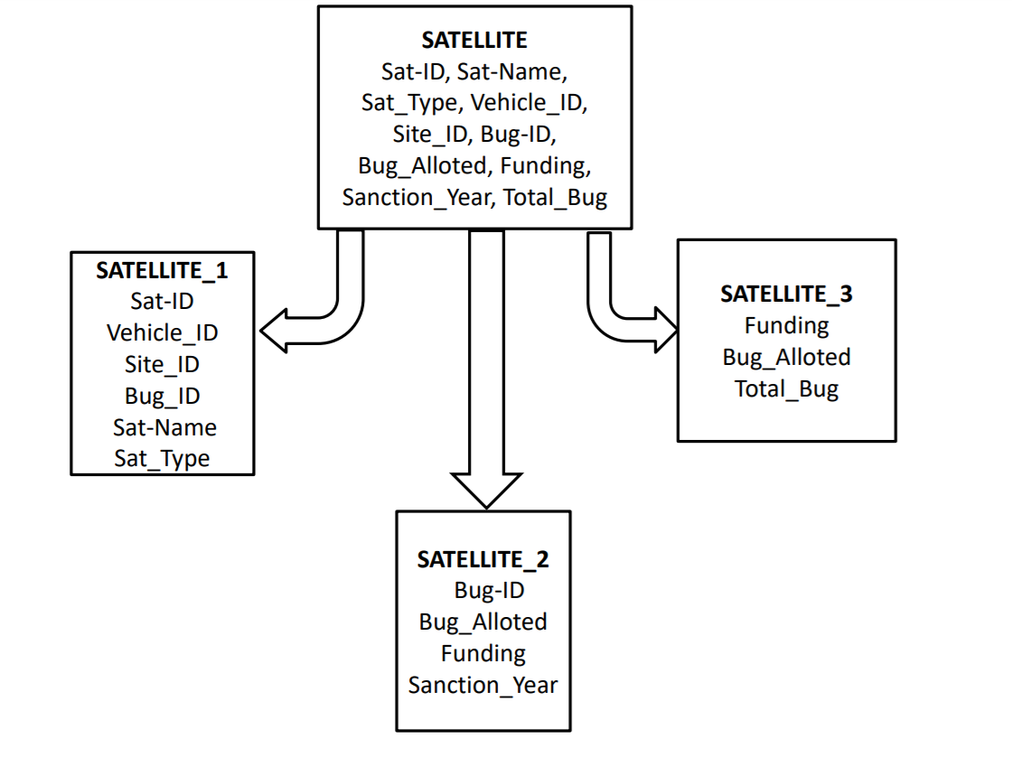

Slide 14
2. Vehicle: (Veh-ID, Veh_Name, Weight)
F.D = { Veh-ID → Veh-Name, Weight }
Candidate key: Veh_ID
Non Prime Attributes: Veh-Name, Weight
This relation is in 1NF as all the attributes in the relation have atomic domains.
This relation is in 2NF as it is already in 1NF and every non-prime attribute is determined by primary key i.e( there is no partial dependency).
This relation is in 3NF as it is already in 2NF and there is no transitive dependency i.e. no non-prime attribute is determined by non-prime attribute.
This relation is in BCNF as it is already in 3NF and LHS of FD is candidate key.

Slide 15
3. Site: (Site-ID, Site_Name, Site_City, Site_State)
F.D = { Site-ID → Site-Name, Site_City, Site_State;
Site_Name→Site_City, Site_State;
Site_City→Site_State }
Candidate key: Site_ID
Non Prime Attributes: Site-Name, Site_City, Site_State

Slide 16
This relation is in 1NF as all the attributes in the relation have atomic domains.
This relation is in 2NF as it is already in 1NF and non-prime attribute is not determined by part of candidate key i.e( there is no partial dependency).
This relation is not in 3NF as there is transitive dependency since Site_Name which is non prime attribute determines Site_City and Site_State which are non prime attributes, also Site_City detemines Site_State. Therefore, we reduce it in 3 relations
Site_1 :{ Site-ID → Site-Name}
Site_2: {Site_Name→ Site_City }
Site_3: {Site_City→ Site_State }
Now, This relation is in BCNF as it is already in 3NF and LHS of every FD is candidate key.

Slide 17
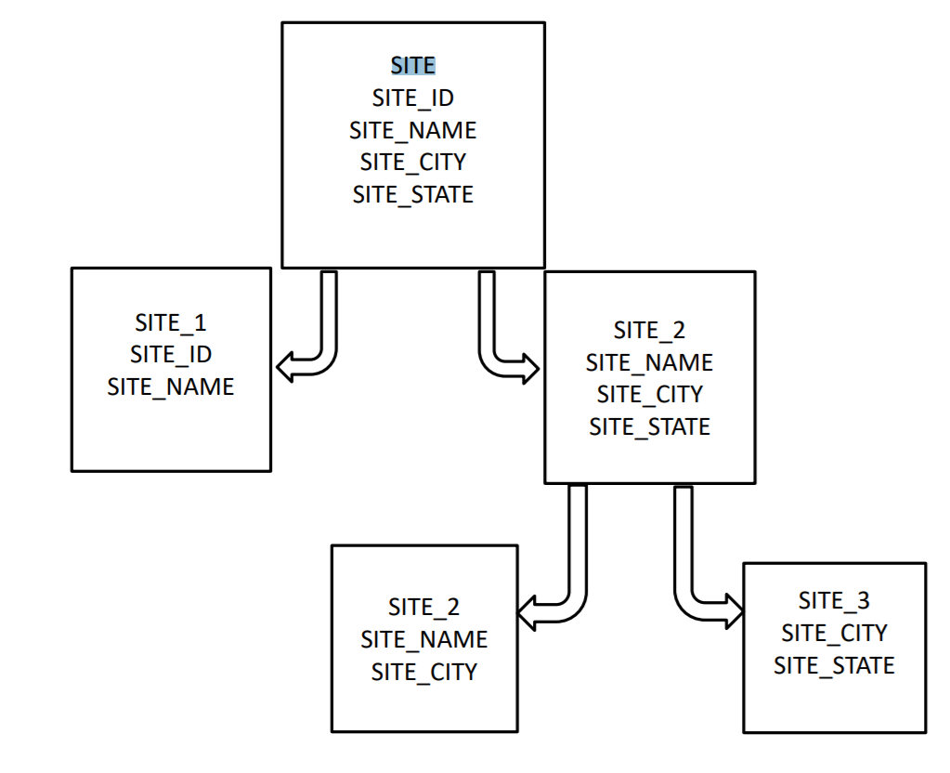

Slide 18
4. Details: (Site_ID, Heaviest_Launch, Launch_Pads)
F.D = {Site-ID, Heaviest_Launch → Launch_Pads }
Candidate key: Site_ID, Heaviest_Launch (Here combination of strong entity’s primary key and partial key of details act as a CK)
Non Prime Attributes: Launch_Pads
This relation is in 1NF as all the attributes in the relation have atomic domains.
This relation is in 2NF as it is already in 1NF and every non-prime attribute is determined by primary key i.e( there is no partial dependency).
This relation is in 3NF as it is already in 2NF and there is no transitive dependency i.e. no non-prime attribute is determined by non-prime attribute.
This relatio is in BCNF as it is already in 3NF and LHS of FD is candidate key. n

Slide 19
Relational algebra queries

Slide 20
group: Satellite
Satellite_1 = {
Sat_ID, Sat_Name, Sat_Type, Veh_ID, Site_ID, Bug_ID
101, 'INSAT_1A', 'Communicatio', 240, 160, 89
102, 'INSAT_2B', 'Navigation', 215, 175, 87
103, 'INSAT_3C', 'GPS', 240, 160, 55
104, 'INSAT_4D', 'Ground Monitoring', 215, 155, 17
105, 'INSAT_5E', 'Polar', 205, 175, 92
}
DATA INPUT FOR RA-QUERIES
Vehicle = {
Veh_ID, Veh_name, Weight
205, 'PSLV', 3800
215, 'GSLV', 5000
240, 'ASLV', 1500
}
Site_3 = {
Site_City, Site_state
'Sriharikota', 'Andhra Pradesh'
'Thumba', 'Kerala'
'Bhadrak', 'Odisha'
}
Satellite_2 = {
Bug_ID, Bug_Alloted, Sanction_Year, Funding
89, 1600, 1947, 1661
87, 1775, 1965, 116
55, 2025, 1968, 611
17, 3035, 2000, 191
92, 3985, 2010, 161
}
Site_1 = {
Site_ID, Site_Name
155, 'SDSC'
160, 'VSSC'
175, 'DAISC'
}
Details = {
Site_ID, Launch_Pads, Heaviest_Launch
155, 2, 690000
160, 3, 520000
175, 2, 460100
}
Site_2 = {
Site_Name, Site_City
'SDSC', 'Sriharikota'
'VSSC', 'Thumba'
'DAISC', 'Bhadrak'
}
Satellite_3 = {
Bug_Alloted, Funding, Total_Bug
1600, 1661, 3261
1775, 116, 1891
2025, 611, 2636
3035, 191, 3226
3985, 161, 4146
}

Slide 21
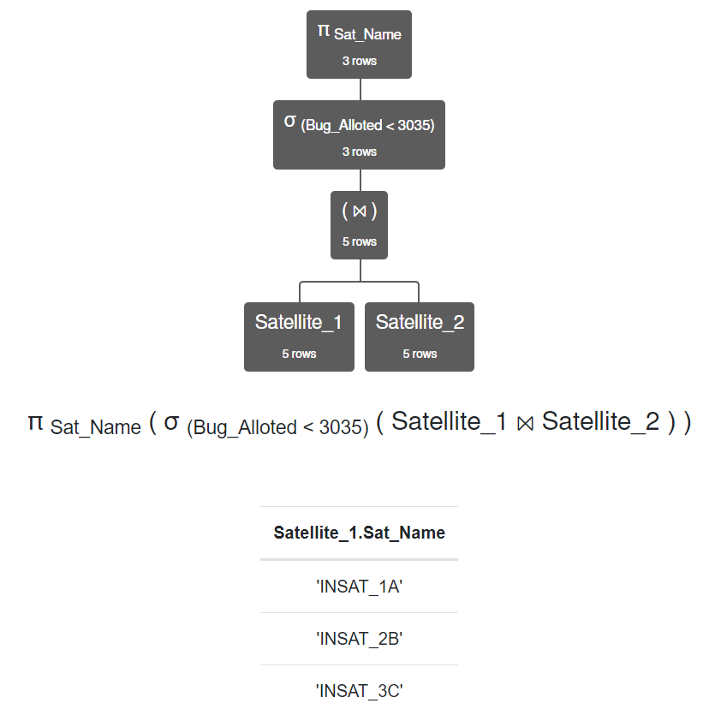
Display all the satellite names which have allotted budget less than 3035cr?

Slide 22
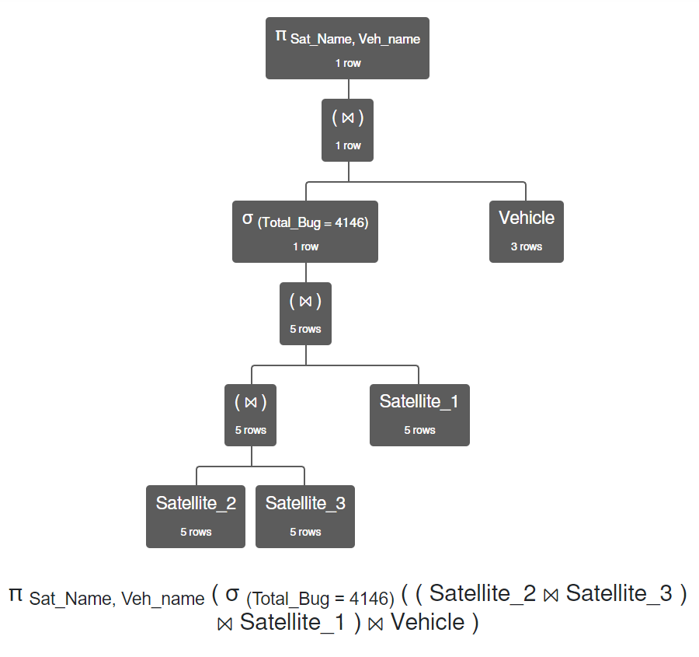
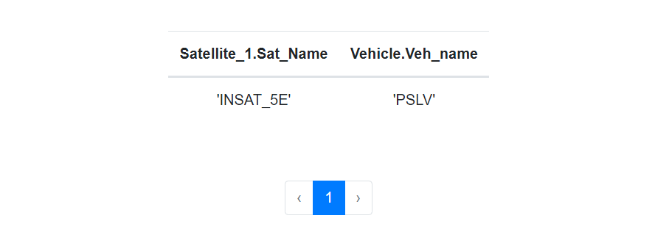
Display name of the satellite and the vehicle with total budget of 4146Cr?

Slide 23
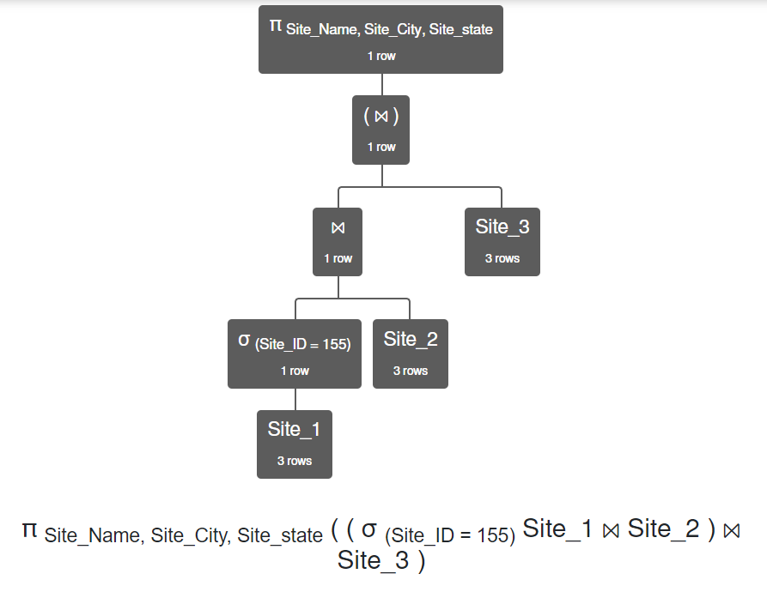
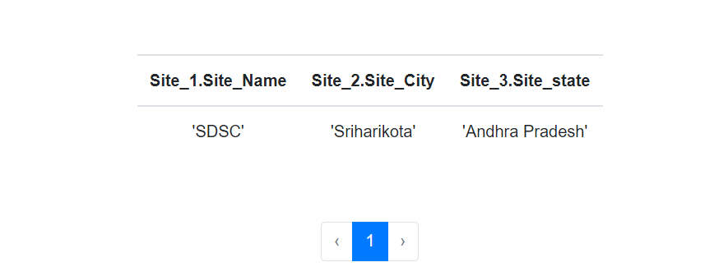
Display the full location of site having ID=155?

Slide 24
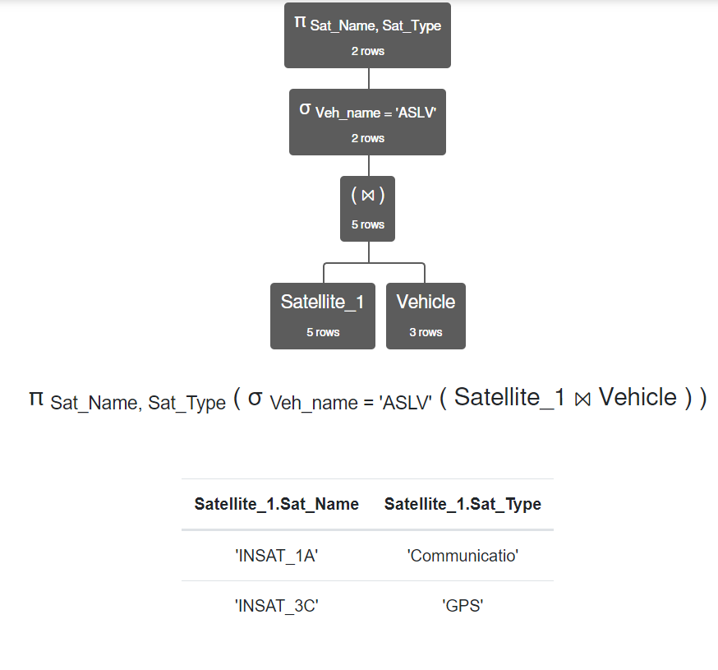
Display all the satellites and their types launched by the vehicle ‘ASLV’?

Slide 25
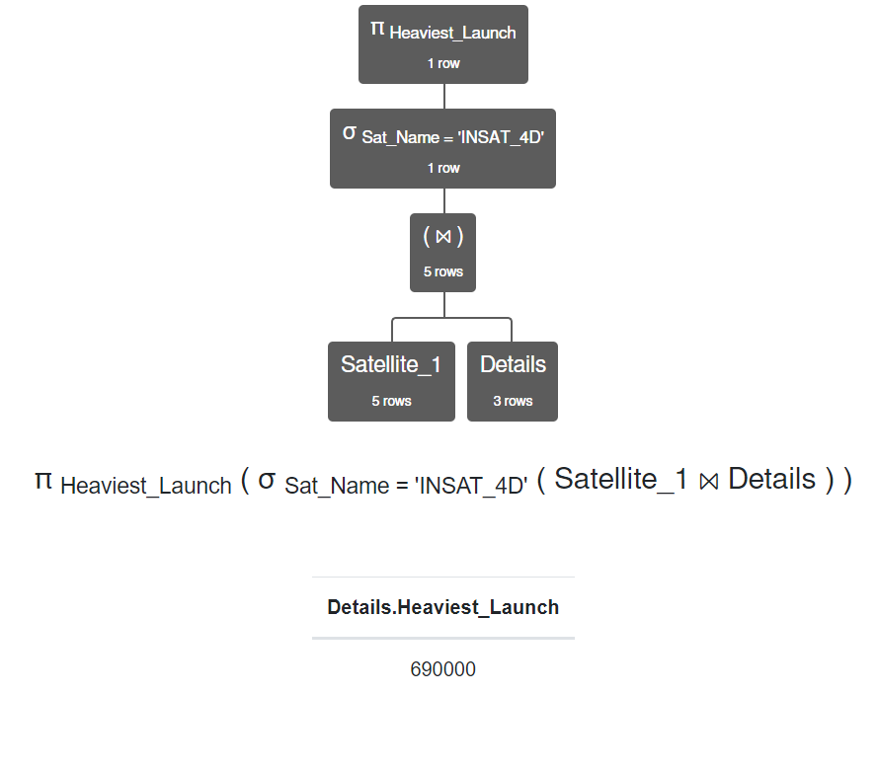
Display heaviest launch of the site from where ‘INSAT_4D’ was launched?

Slide 26
Sql queries

Slide 27
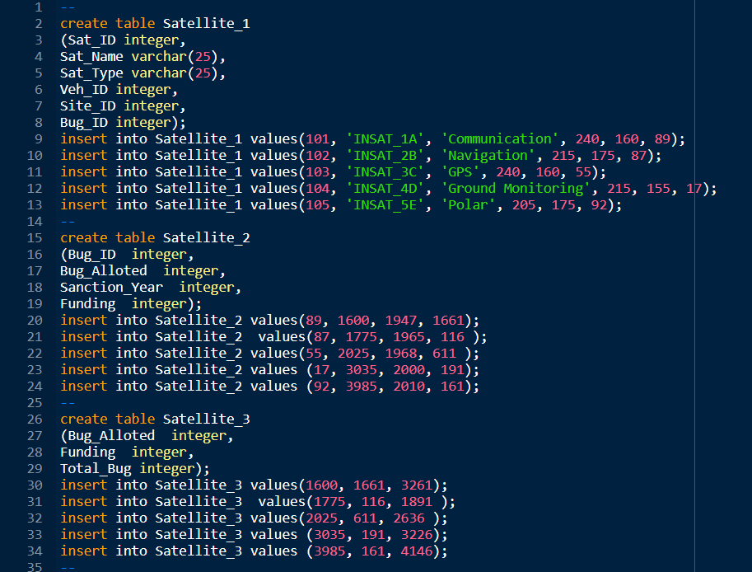
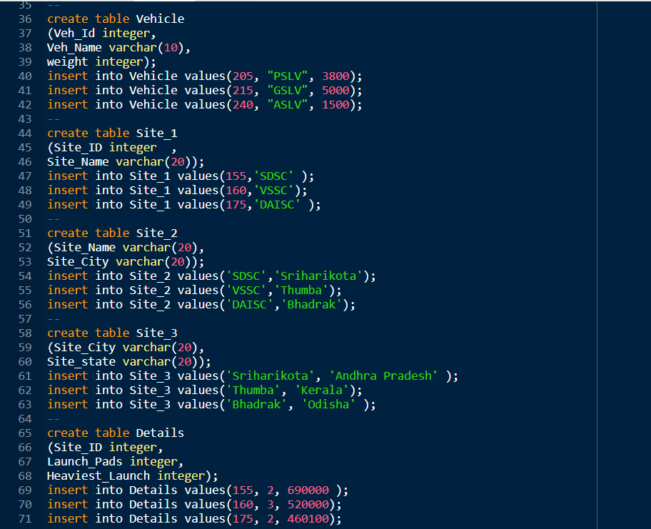
DATA INPUT FOR SQL QUERIES

Slide 28
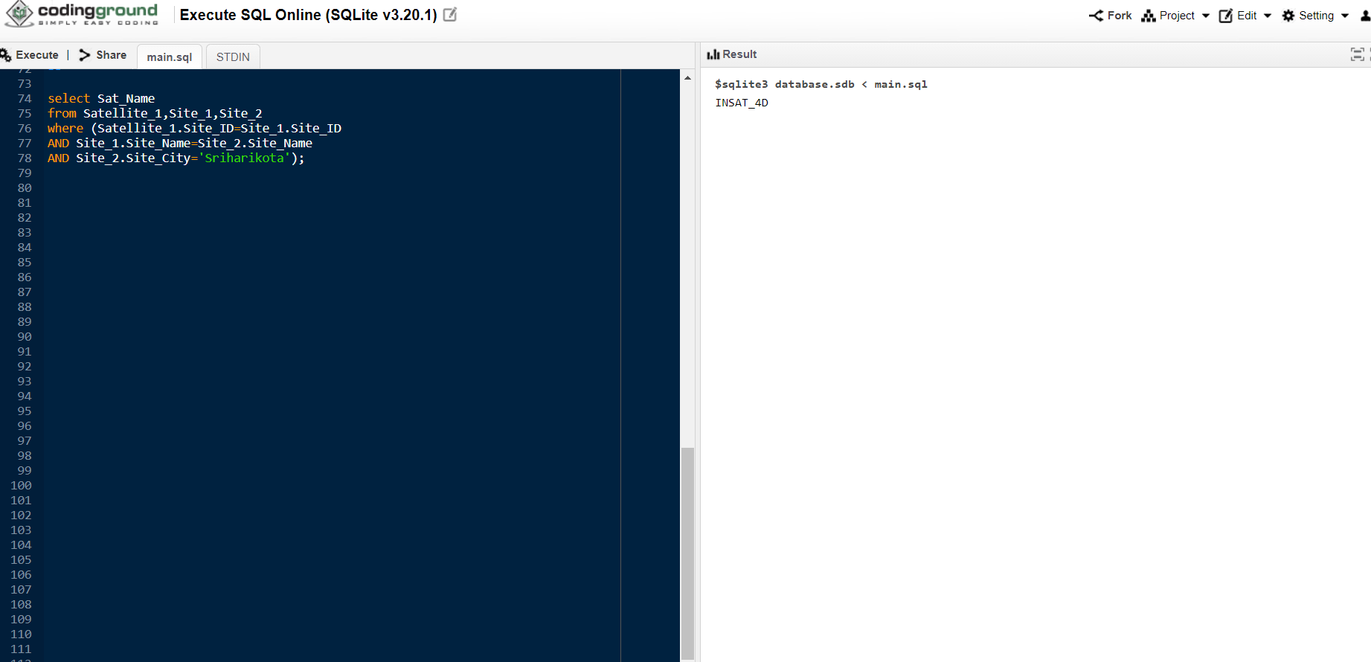
Write a sql query to find out satellite name for satellite which is launched from sriharikota?

Slide 29
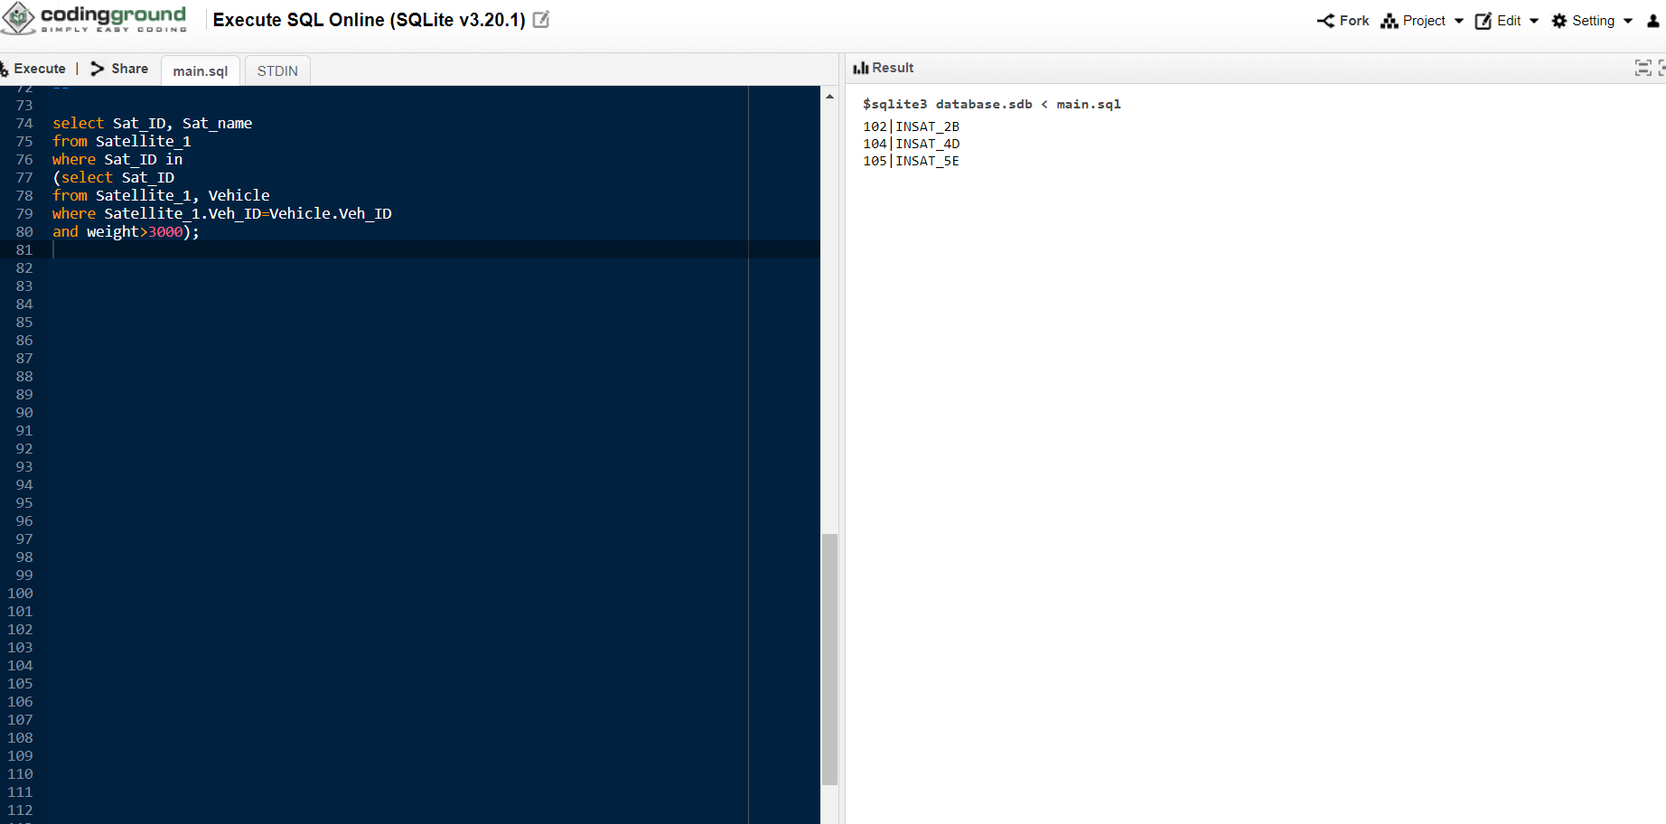
Write a sql query to find out satellite id and satellite name of all those satellite who are carried by vehicle whose maximum payload capacity is greater than 3000?

Slide 30
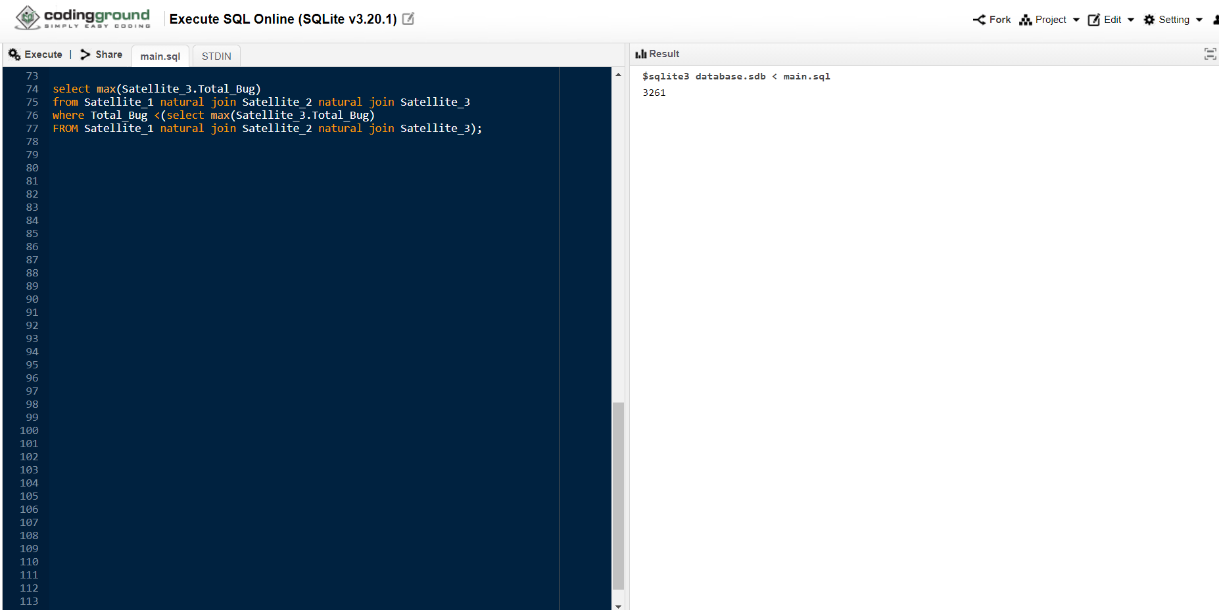
Write a sql query to find second highest total budget?

Slide 31
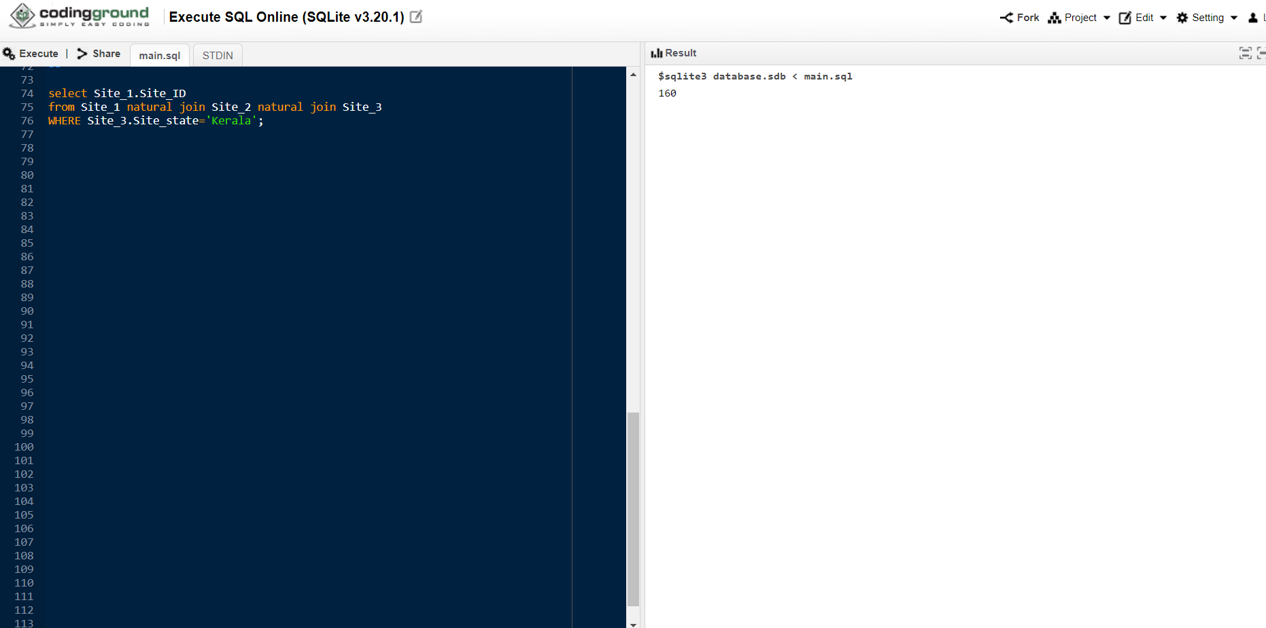
Write a sql query to find out the site-id of a site which is located in Kerala.?

Slide 32

Write a sql query to find the count of satellite which are launched from sites having 2 launch pads?

Slide 33
THANK YOU

